Slide 1
Overwhelming human forces
Joey Simone, Individual presentation
Notes:
My presentation is on the Carriage of Goods at Sea Act, section 4, immunity of the ship from liability.

Slide 2

Neither the carrier nor the ship shall be responsible for loss or damage arising or resulting from
"(e) Act of war;
"(f) Act of public enemies;
"(g) Arrest or restraint of princes, rulers, or people, or seizure under legal process;
Photo: Ebet Roberts/Redferns
46 USC 30701 § 4.2
Via (Schoenbaum, 2019)

Slide 3
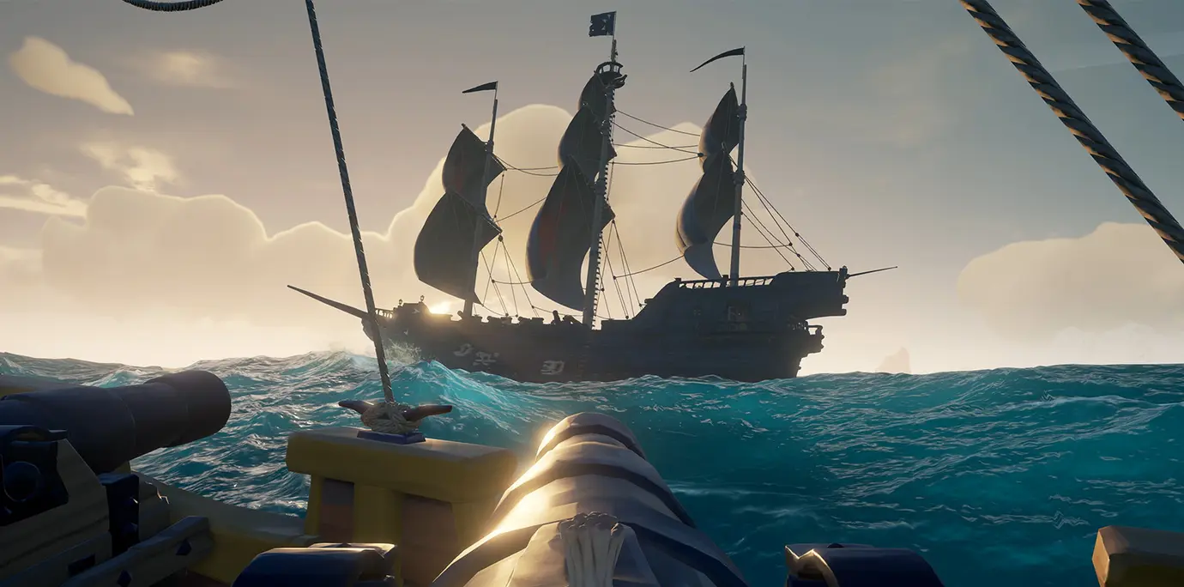
Not in the ship’s control
Photo Credit Max Wales, Eurogamer

Slide 4
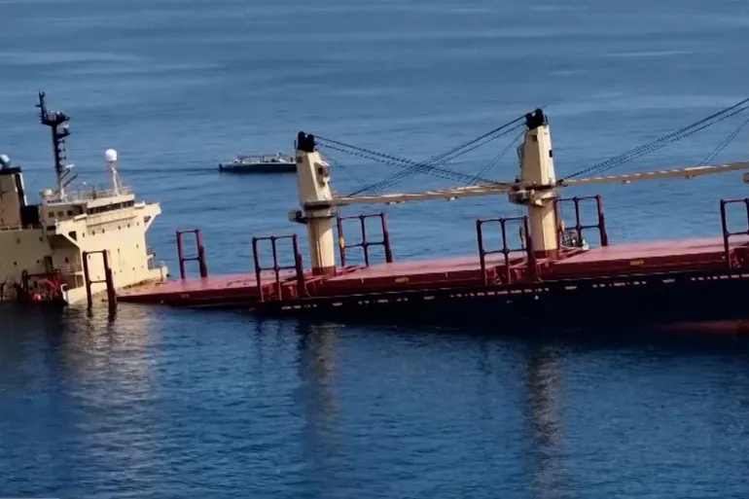
The sinking of the Rubymar
Ship and Carrier will not be held liable for the loss of the cargo (Hague-Visby Rules (1924, 1968, 1979), n.d.)
Even if they were, there is a maximum fee of 2000SDR/3 per package (Admin, 2024)
The Rubymar was hit by Houthi rebels on February 18 [Al Jazeera]

Slide 5
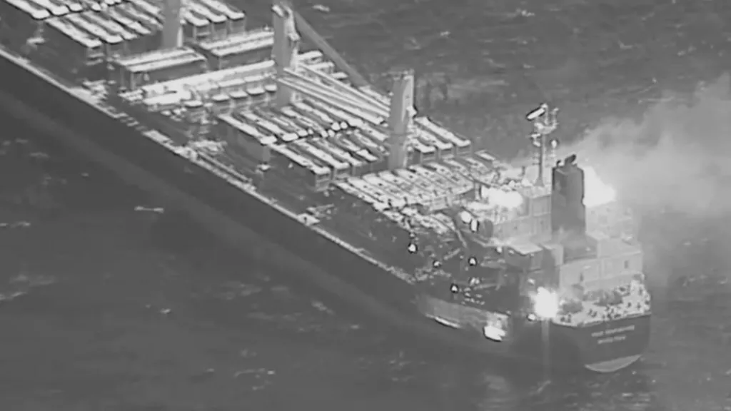
Even when the ship is not lost
True Confidence abandoned after missile strike (Tom Spender et al., 2024)

Slide 6
Any Distinction Between Rebels and Military?
Houthis are Legal Combatants
This is an Act of War
(e) Acts of War
Ship and Carrier not Liable
Houthis are not Legal Combatants
They are terrorists
(f) Acts of Public Enemies
Ship and Carrier not Liable

Slide 7

But Rubymar is Foreign?
The Hague, Netherlands. Andrew Ward—Life File/Getty Images
Notes:
The COGSA is just the US implementation of the Hague Rules, “International Convention for the Unification of Certain Rules of Law relating to Bills of Lading, and Protocol of Signature”, so the Rubymar is covered under that language. Article 4 has the exact same language as our own section 4, and the order is the same, so e and f for war and public enemies still apply.

Slide 8
Works Cited
“Act ‘That Every Bill of Lading or Similar Document of Title Which Is Evidence of a Contract for the Carriage of Goods by Sea to or from Ports of the United States, in Foreign Trade, Shall Have Effect Subject to the Provisions of This Act.’” Title 46-Shipping, vol. 46 USC 30701, 16 Apr. 1936, https://uscode.house.gov/view.xhtml?req=granuleid:USC-prelim-title46-section30701&num=0&edition=prelim.
Admin. Hague-Visby Rules Package Limitation | HandyBulk. 1 Apr. 2024, https://www.handybulk.com/hague-visby-rules-package-limitation/.
Hague-Visby Rules (1924, 1968, 1979). http://www.dutchcivillaw.com/legislation/haguevisbyrules.htm. Accessed 10 Apr. 2024.
International Convention for the Unification of Certain Rules of Law Relating to Bills of Lading (The Hague Rules) - The Faculty of Law. https://www.jus.uio.no/english/services/library/treaties/07/7-04/hague-rules.html. Accessed 10 Apr. 2024.
“Prince Dead at 57: The Musician Has Died in Minnesota.” Peoplemag, https://people.com/celebrity/prince-dead-at-57-the-musician-has-died-in-minnesota/. Accessed 9 Apr. 2024.
Schoenbaum, Thomas J. Admiralty and Maritime Law. Sixth edition, West Academic Publishing, 2019.
The Hague | History, Art Museums, Convention, Court, Map, & Facts | Britannica. 6 Apr. 2024, https://www.britannica.com/place/The-Hague.
“This Is the MV True Confidence Ship Attacked by Yemeni Houthi Rebels in the Gulf of Aden.” ContentEngine LLC, a Florida Limited Liability Company, 8 Mar. 2024, https://login.ezproxy.csum.edu/login?url=https://www.proquest.com/wire-feeds/this-is-mv-true-confidence-ship-attacked-yemeni/docview/2954391748/se-2.
Tom Spender, et al. “Three Killed in Houthi Missile Attack on Cargo Ship in Gulf of Aden.” British Broadcasting Corporation, 7 Mar. 2024. www.bbc.com, https://www.bbc.com/news/world-middle-east-68490695.
“UK Cargo Ship Hit by Yemen’s Houthis Sinks in the Red Sea.” Al Jazeera, https://www.aljazeera.com/news/2024/3/2/rubymar-cargo-ship-earlier-hit-by-houthis-has-sunk-yemeni-government-says. Accessed 9 Apr. 2024.
Wright, Robert. “Crew Abandon Ship in Most Damaging Strike yet by Yemen’s Houthis.” FT.Com, 19 Feb. 2024, https://login.ezproxy.csum.edu/login?url=https://www.proquest.com/trade-journals/crew-abandon-ship-most-damaging-strike-yet-yemen/docview/2928145518/se-2?accountid=10353. ABI/INFORM Collection; Global Newsstream, 2928145518.

